Slide 1


Linked Data Connections in App Inventor
Lalana Kagal, Evan Patton, Fuming Shih, and Oshani Seneviratne
(oshani@mit.edu)

Slide 2
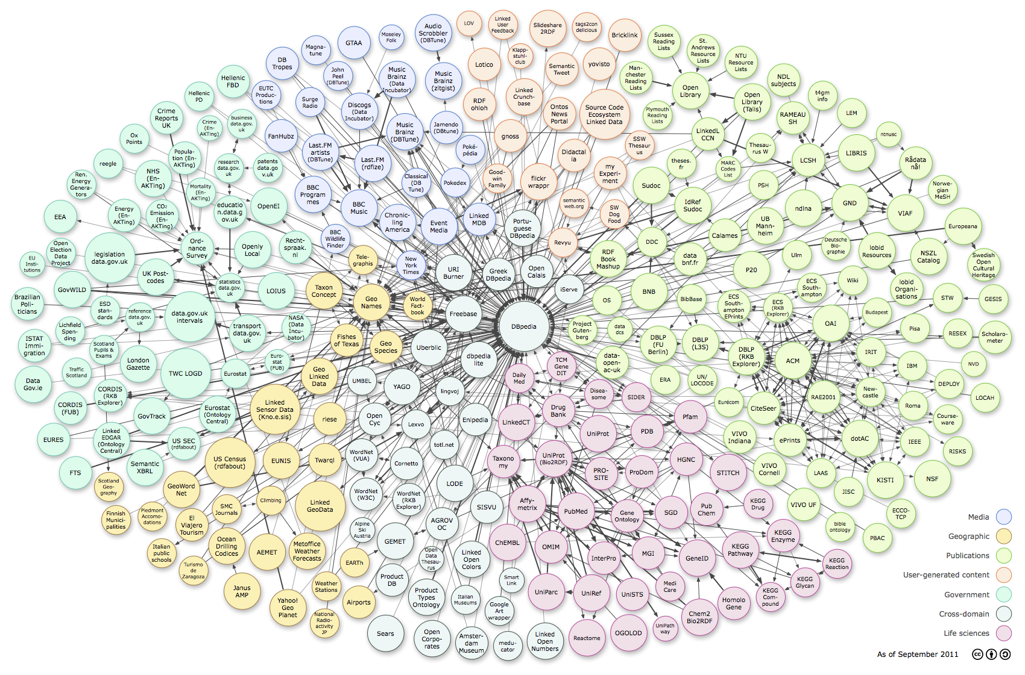
Linked Data

Slide 3
Linked Data Evolution
2007 → now

Slide 4
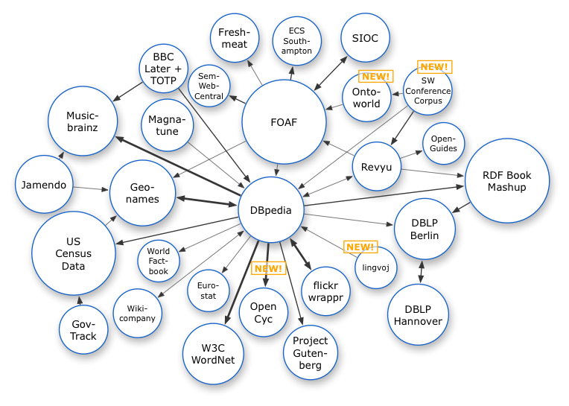

Slide 5
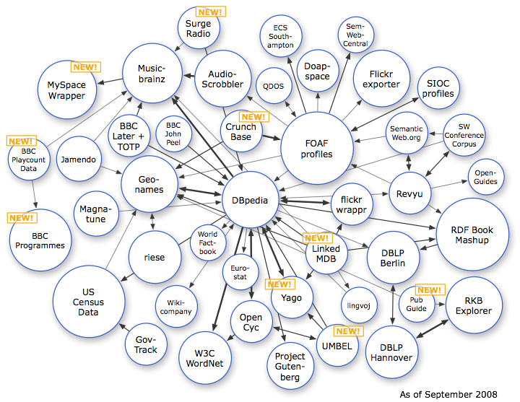

Slide 6
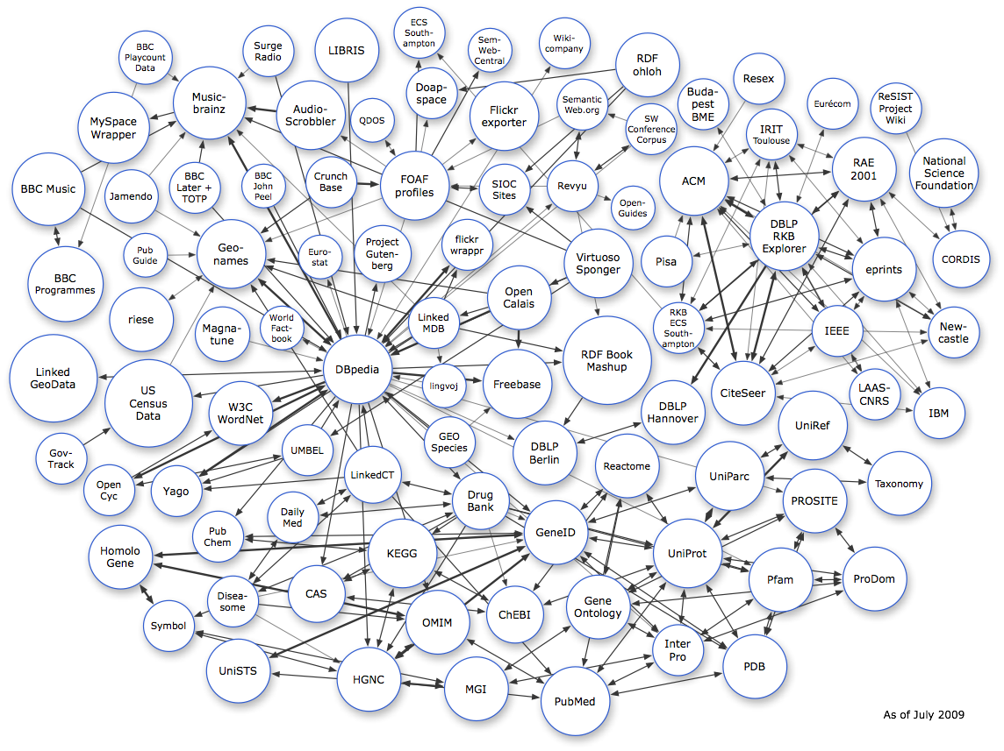

Slide 7
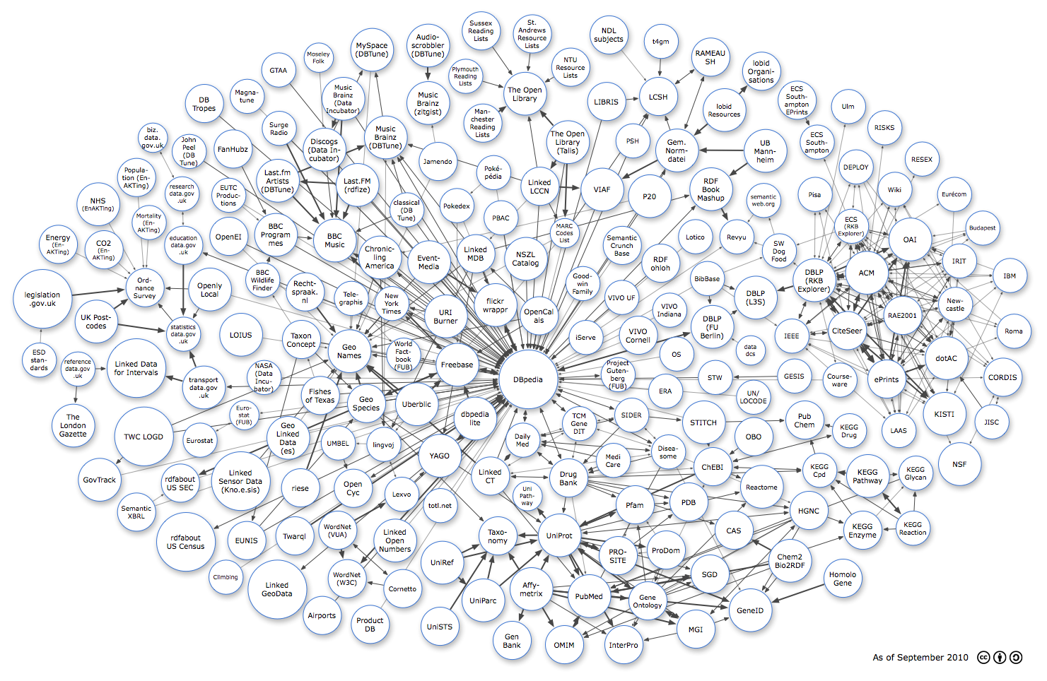

Slide 8
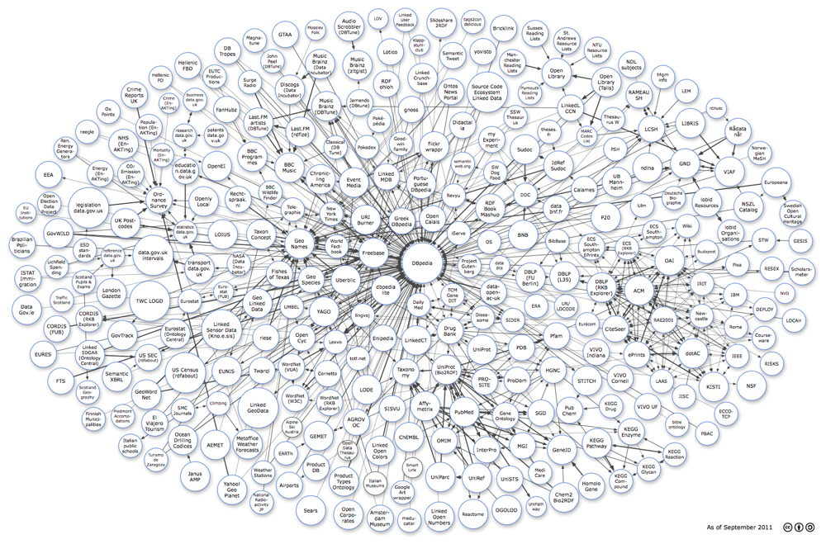

Slide 9
Why use Linked Data?
Enormous wealth of open data
Uniform Resource Identifiers (URIs) enable interconnections between datasets, unlike data in traditional databases

Slide 10
How to work with linked data?
To consume:
Query using SPARQL
To produce:
Create “triples” and/or “graph” structures using Resource Description Framework (RDF)

Slide 11
Our goals
Introduce linked data to App Inventor
Hide the complexity of RDF, SPARQL when developing mobile apps

Slide 12
The App Inventor Components

Slide 13
SemanticForm
A new app inventor layout
Creates an RDF model based the contents in the form
Can create more complex structures with nested forms
The form can mint new URIs using their contents

Slide 14
SemanticWeb
Provides methods for:
Reading RDF
Storing and manipulating RDF on the device
Writing out an RDF model to a triple store

Slide 16
SemanticWebListPicker
Extends the List Picker component
Auto-populates contents from a triple store

Slide 17
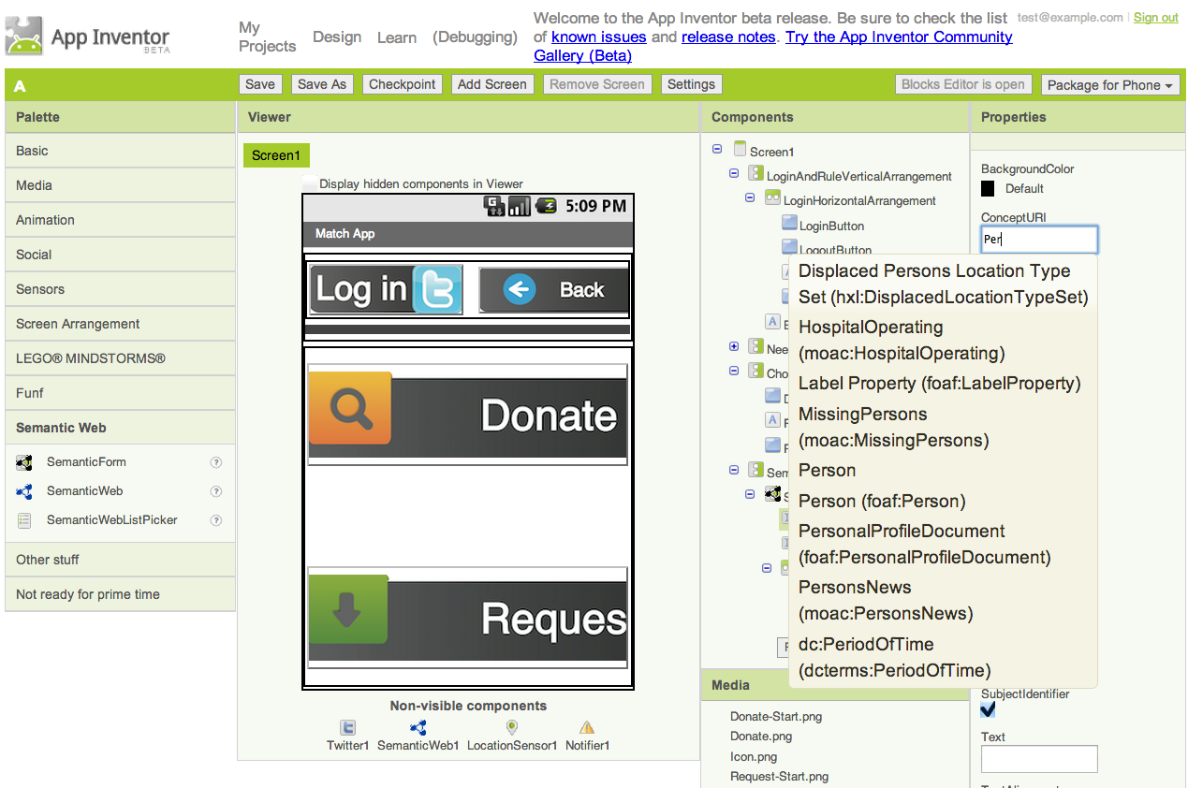

Slide 18

“MatchApp” Demo
A mobile application that can be easily built using disaster scenarios
Donors can input information about donations
People in the disaster areas can search for those resources and request them via Twitter

Slide 19
Check us out!
Source Code:
https://github.com/mit-dig/appinventor-sources
DIY Mobile App Development for Disaster Management
http://dig.csail.mit.edu/2013/QCRI-DIG-project

Slide 20
Thank You!

